Slide 1
Image Enhancement
Spatial Domain

Slide 2
Image enhancement
Enhancing an image provides better contrast and a more detailed
image.
Image enhancement applications:
used to enhance medical images , images captured in remote sensing , images from satellite e.t.c
The transformation function has been given below
s = T ( r )
where r is the pixels of the input image and s is the pixels of the output image.
T is a transformation function that maps each value of r to each value of
s. Image enhancement can be done through gray level transformations

Slide 3
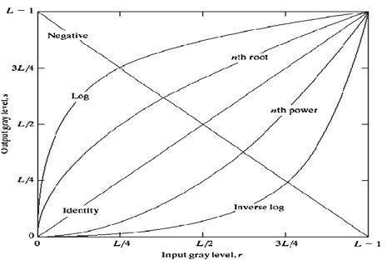
Gray level transformation
There are three basic gray level transformation.
Linear
Logarithmic
Power – law

Slide 4
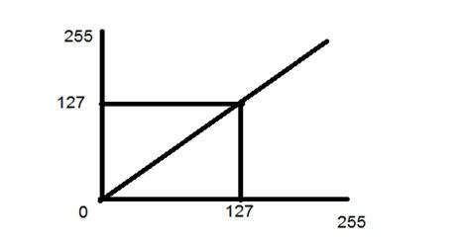
Linear transformation
Types of Linear transformation
Identity
Negative
Identity transition is shown by a straight line in the figure.
In this transition, each value of the input image is directly mapped to each other value of output image.
That results in the same input image and output image

Slide 5
Negative transformation
The second linear transformation is negative transformation, which is invert of identity transformation. In negative transformation, each value of the input image is subtracted from the L-1 and mapped onto the output image.
In this case the following transition has been done.
s = (L – 1) – r
since the input image of Einstein is an 8 bpp image , so the number of levels in this image are 256.
s = 255 – r
The lighter pixels become dark and the darker picture becomes light. And it results in image negative.

Slide 6
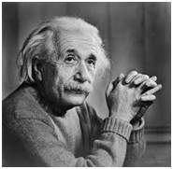
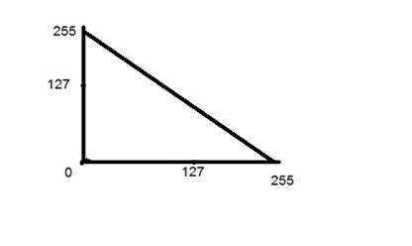
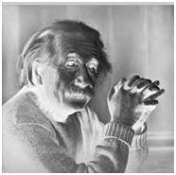
Negative Transformation
Input Image
Output Image

Slide 7
Logarithmic transformations
The log transformations can be defined by this formula
s = c log(r + 1)
Where s and r are the pixel values of the output and the input image and c is a constant.
The value 1 is added to each of the pixel value of the input image because if there is a pixel intensity of 0 in the image, then log (0) is equal to infinity. So 1 is added , to make the minimum value at least 1.
During log transformation , the dark pixels in an image are expanded as compare to the higher pixel values. The higher pixel values are kind of compressed in log transformation.
The value of c in the log transform adjust the kind of enhancement.

Slide 8
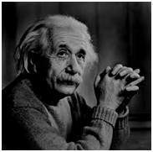
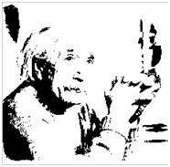
Log transformation
Input Image
Output Image

Slide 9
Power – Law transformations
There are further two transformation is power law transformations, that include nth power and nth root transformation. These transformations can be given by the expression:
s=cr^γ
This symbol γ is called gamma, due to which this transformation is also known as gamma transformation.
Variation in the value of γ varies the enhancement of the images. Different display devices / monitors have their own gamma correction, that’s why they display their image at different intensity.
This type of transformation is used for enhancing images for different type of display devices. The gamma of different display devices is different. For example Gamma of CRT lies in between of 1.8 to 2.5 , that means the image displayed on CRT is dark.
Correcting gamma.
s=cr^γ
s=cr^(1/2.5)

Slide 10
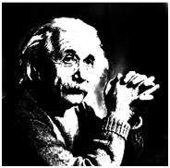
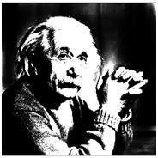
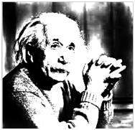
Power – Law transformations
Input Image
Gamma=10
Gamma=8
Gamma=6

Slide 11
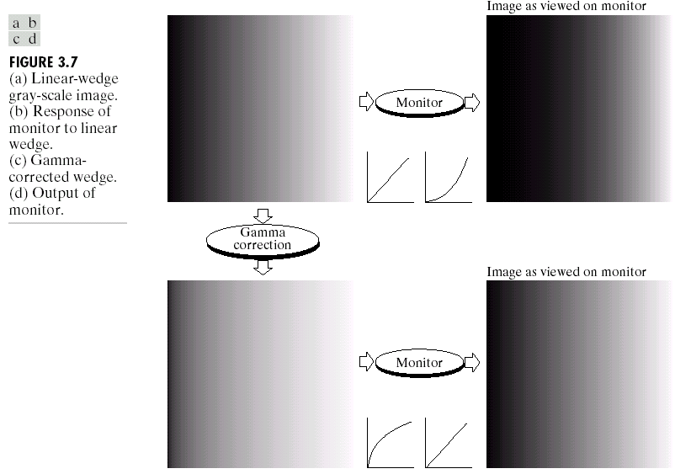
Used for gamma-correction

Slide 12
Piecewise-Linear Transformation Functions
Principle Advantage: Some important transformations can be formulated only as a piecewise function.
Principle Disadvantage: Their specification requires more user input that previous transformations
Types of Piecewise transformations are:
Contrast Stretching
Gray-level Slicing
Bit-plane slicing

Slide 13
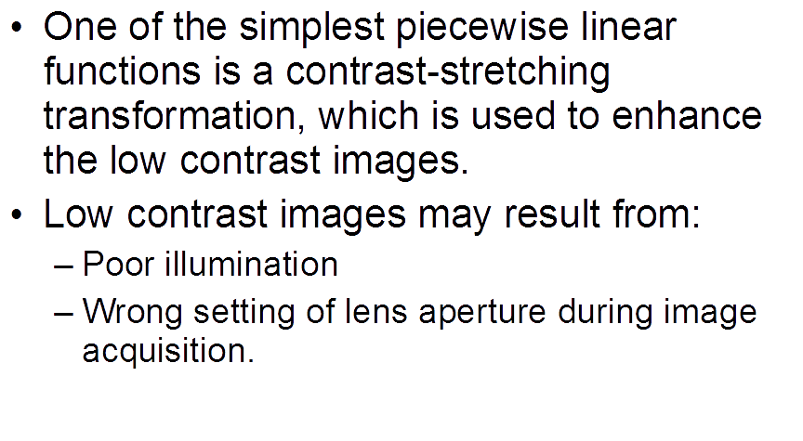
Contrast Stretching

Slide 14
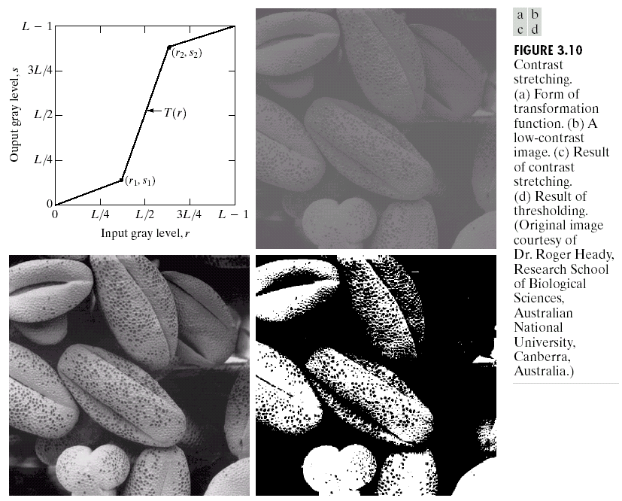
Contrast Stretching

Slide 15
Contrast Stretching
Figure a) shows a typical transformation used for contrast stretching.
The locations of points (r1, s1) and (r2, s2) control the shape of the transformation function.
If r1 = s1 and r2 = s2, the transformation is a linear function that produces no changes in gray levels.
If r1 = r2, s1 = 0 and s2 = L-1, the transformation becomes a thresholding function that creates a binary image.
Intermediate values of (r1, s1) and (r2, s2) produce various degrees of spread in the gray levels of the output image, thus affecting its contrast.
In general, r1 ≤ r2 and s1 ≤ s2 is assumed, so the function is always increasing.

Slide 16
Contrast Stretching
Figure b) shows an 8-bit image with low contrast.
Figure c) shows the result of contrast stretching, obtained by setting (r1, s1) = (r_{min}, 0) and (r2, s2) = (r_{max},L-1) where r_{min} and r_{max} denote the minimum and maximum gray levels in the image, respectively. Thus, the transformation function stretched the levels linearly from their original range to the full range [0, L-1].
Finally, Fig. 3.10(d) shows the result of using the thresholding function defined previously, with r1=r2=m, the mean gray level in the image.

Slide 17
Gray-level Slicing
This technique is used to highlight a specific range of gray levels in a given image.
It can be implemented in several ways, but the two basic themes are:
One approach is to display a high value for all gray levels in the range of interest and a low value for all other gray levels. This transformation, shown in Fig (a), produces a binary image.
The second approach, based on the transformation shown in Fig (b), brightens the desired range of gray levels but preserves gray levels unchanged.
Fig (c) shows a gray scale image, and fig (d) shows the result of using the transformation in Fig (a).

Slide 18
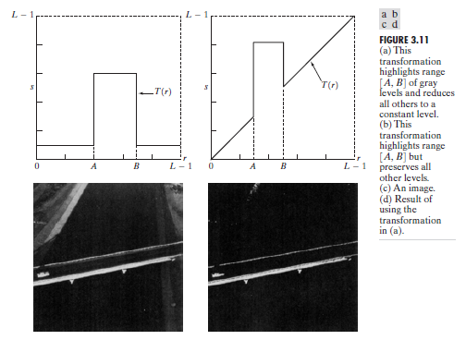
Gray-level Slicing

Slide 19
Bit-plane Slicing
Pixels are digital numbers, each one composed of bits. Instead of highlighting gray-level range, we could highlight the contribution made by each bit.
This method is useful and used in image compression.
Most significant bits contain the majority of visually significant data.

Slide 20
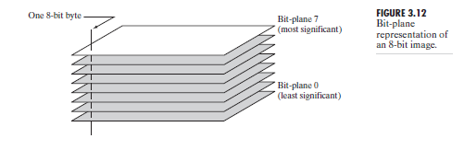
Bit-plane Slicing

